Slide 1
RACISM IN US CRIMINAL JUSTICE SYSTEM
Images

Slide 2
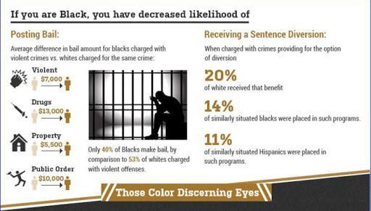
Statistics of racism

Slide 3
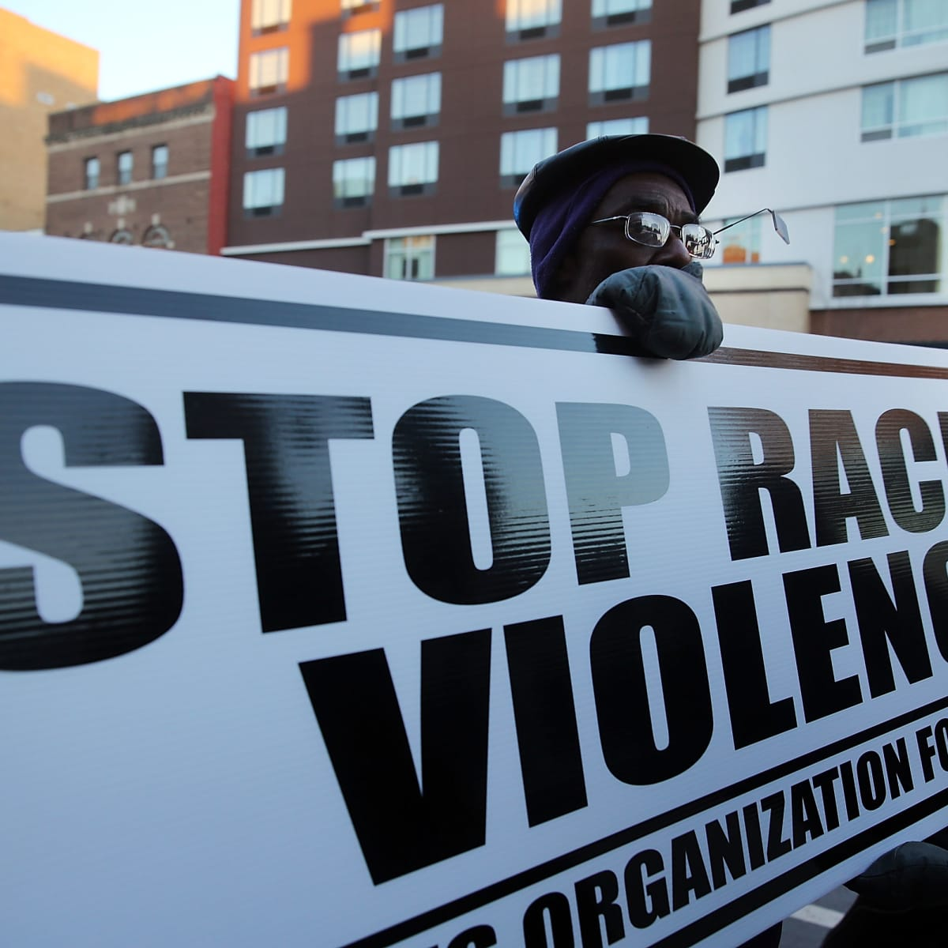
Racism protestors with banners

Slide 4
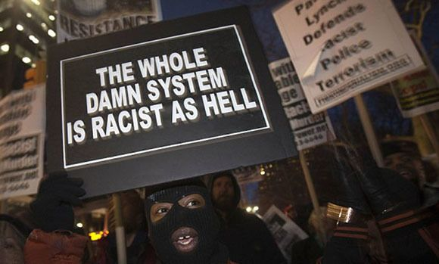
Blacks demonstrating against racism

Slide 5
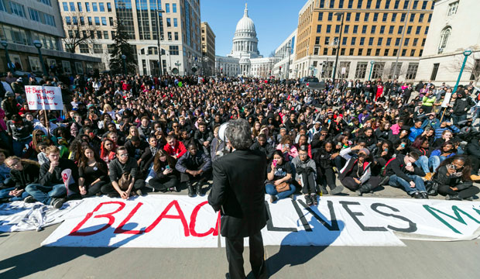
Rally against killing of blacks

Slide 6
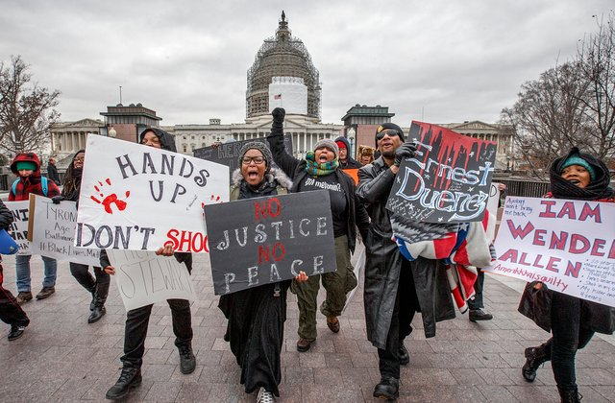
Blacks demonstrating outside courts

Slide 7
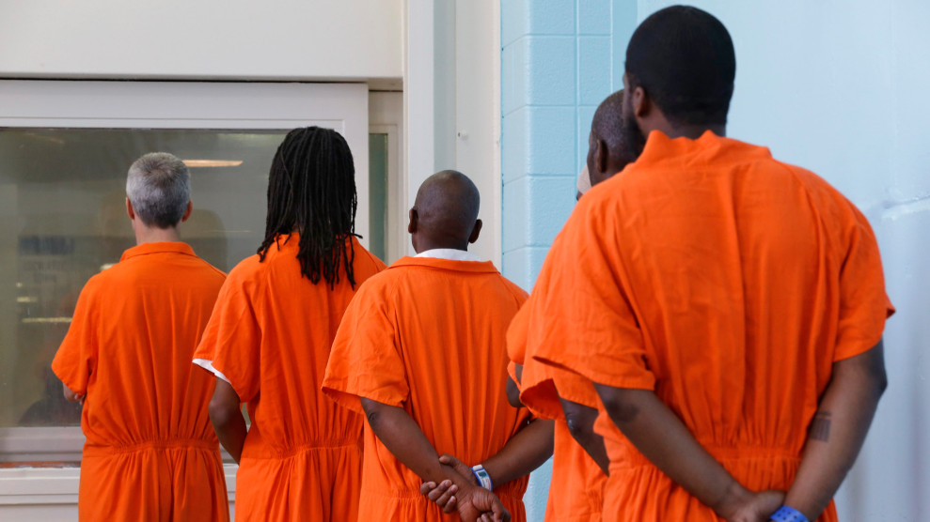
Blacks in prison

Slide 8
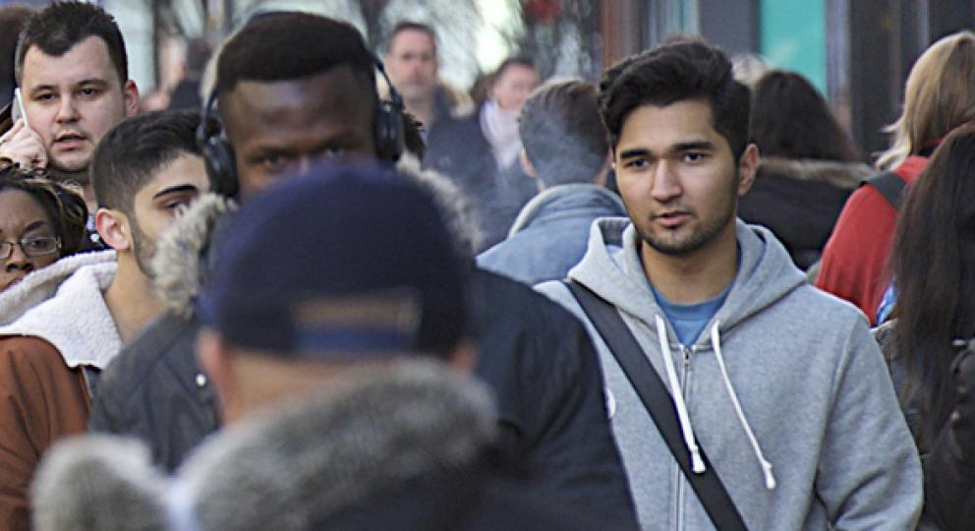
A black being victimized

Slide 9
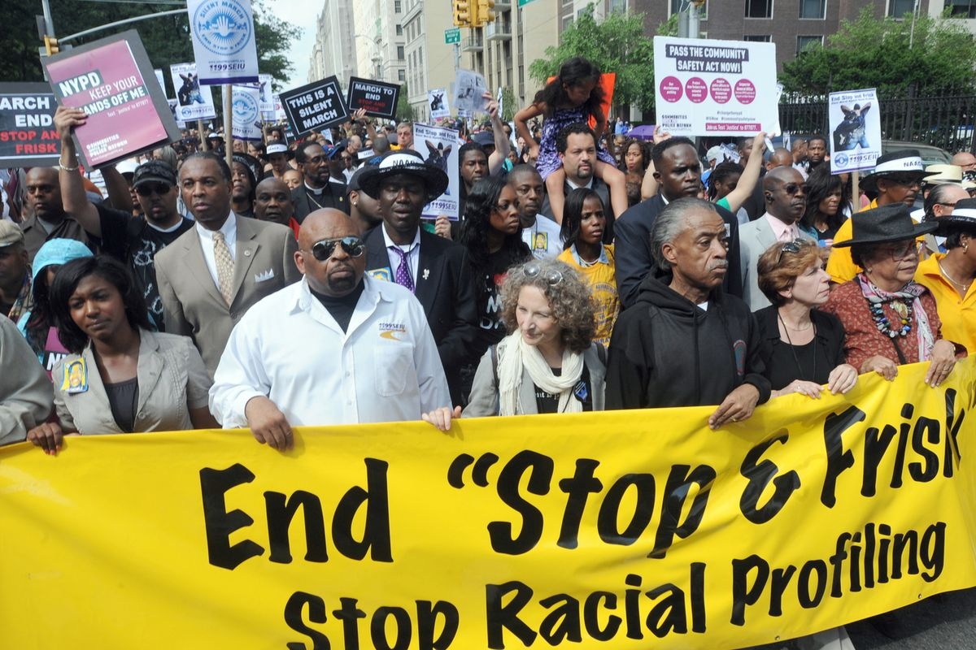
Blacks demonstrating

Slide 10
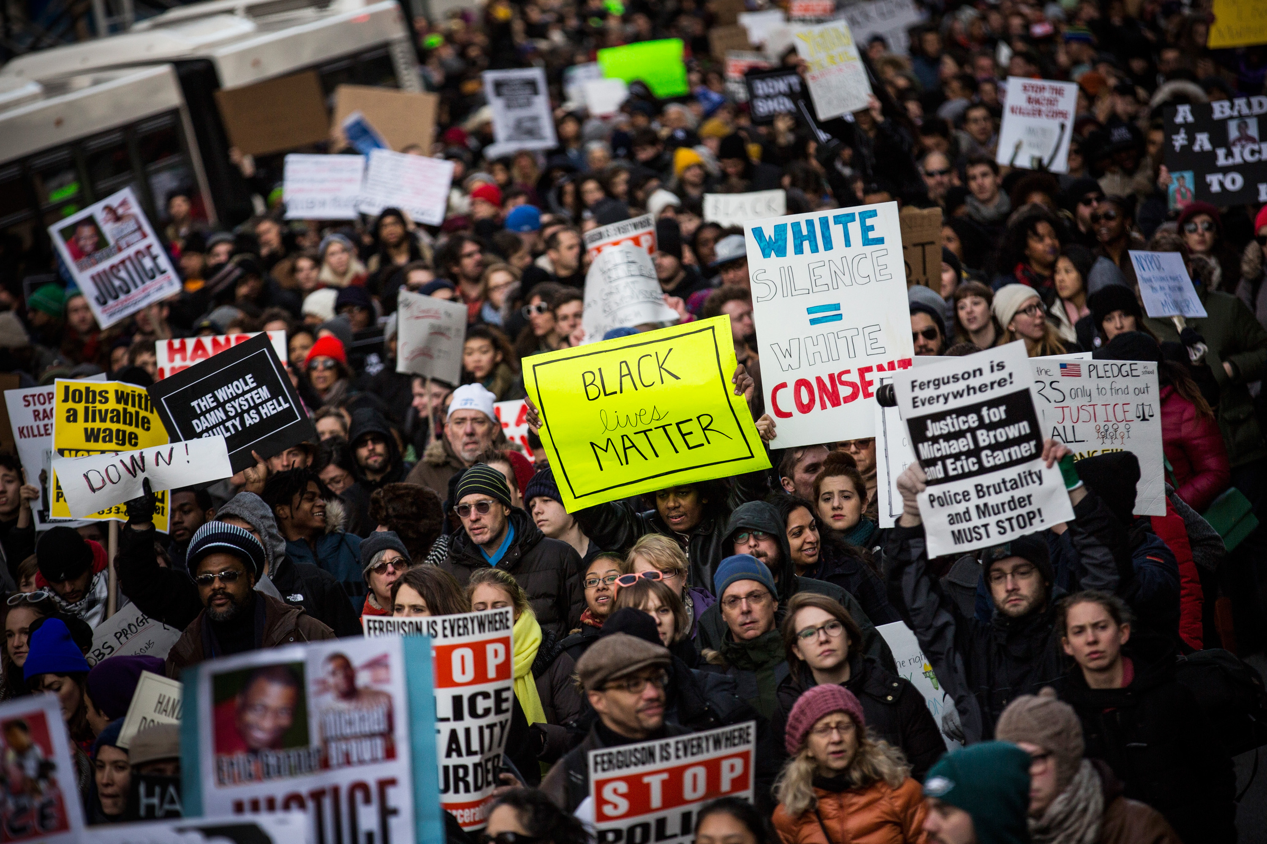

Slide 11
References
https://www.sentencingproject.org/wp-content/uploads/2015/11/Protest-crowd.jpg
https://cms.qz.com/wp-content/uploads/2019/10/AP_19198064138032-e1570807341729.jpg?quality=75&strip=all&w=1600&h=900&crop=1
https://cdn.vox-cdn.com/thumbor/-HZq5wg3NKy4pIuh8vU3tBpFpAA=/285x0:1779x1121/1200x800/filters:focal(285x0:1779x1121)/cdn.vox-cdn.com/uploads/chorus_image/image/36636184/170038226.0.jpg
https://www.equalityhumanrights.com/sites/default/files/styles/mobile_hero_image/public/hero-banner-street-crowd.jpg?itok=OAZzOqke
https://encrypted-tbn0.gstatic.com/images?q=tbn%3AANd9GcSQya-opobCLEJzsHeWvQgTNp4eljxAeTU2mics_Li_VBlYFozv&usqp=CAU
https://www.usnews.com/dims4/USNEWS/55212ec/2147483647/thumbnail/640x420/quality/85/?url=https%3A%2F%2Fmedia.beam.usnews.com%2F2c%2Faf%2F1f7f1e6148259c6a0766d041cd86%2Fap751798006141-12b.jpg
https://cdn.americanprogress.org/wp-content/uploads/2015/05/8FactsCrimJustice.jpg

